Slide 1




Catalyst
ABA Data Collection and Management
Notes:
Supervisors to have ppt, user guide, wifi flyer

Slide 2
Agenda
Catalyst
Set up your Tablet/Catalyst
Purpose
Using the App
Entering Data in the Portal
Where to get Support
Practice Running Trials AND Collecting Data with Catalyst
Notes:
All work tasks should be completed on the tablet.

Slide 3
Setting up Catalyst
Find Catalyst email with username and password
Go to secure.datafinch.com and log in
Click on your name on top right (change password AND change pin)
Then go to app and enter username/password
Allow to sync
Please be sure to share your tablet # with your instructor before we move on!

Slide 4
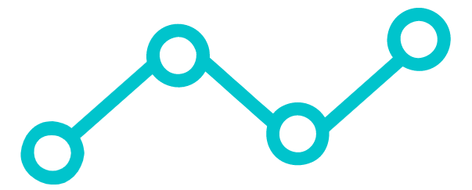
Importance of Data Collection
Why do we collect data?
Understand, improve, and predict clients’ behavior
Objective way to measure progress
YOU use data to make decisions everyday!
Getting stronger - measuring progress by the amount of weight you can lift at the gym
Weight loss/gain - use a scale, fit of clothing
Improving sleep hygiene - use smart watch
Improving finances - bank app and balances

Slide 5
Catalyst- What is it?
Catalyst: System for collecting and managing clinical data (owned by DataFinch)
Catalyst Platform:
Online Portal/Website
Client goals are added, viewed, and changed here
Tablet App
Data collected
Notes:
More specifically…
Information on online portal will sync to the tablet, which enables us to collect data on the tablet. Each sup and BI will have tablet.
If loses internet connection, you can still take data on the tablet, and Catalyst will automatically sync with the portal when internet connection becomes available.

Slide 6

Benefits of Catalyst
Why is electronic data collection/management better than paper and pencil?
Clinical effectiveness/compliance
BCBAs can remotely analyze and make changes to clients’ programs
Less risk for HIPAA violations
All of the information you need to implement a goal is on one spot
More time spent with client and family
To improve the staff workload
No time spent transferring data to another platform for analysis
No manual calculations or graphing
No time spent organizing raw data sheets (Another bonus: saving trees!)
Ease and accuracy of data collection
No errors made transferring data

Slide 7
Catalyst – Using the App

Slide 8
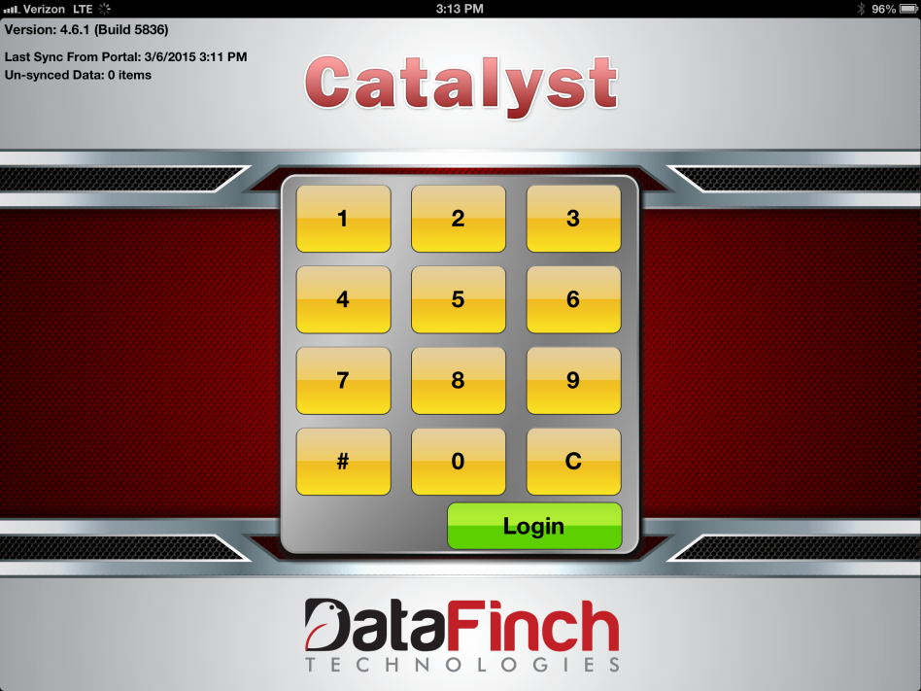
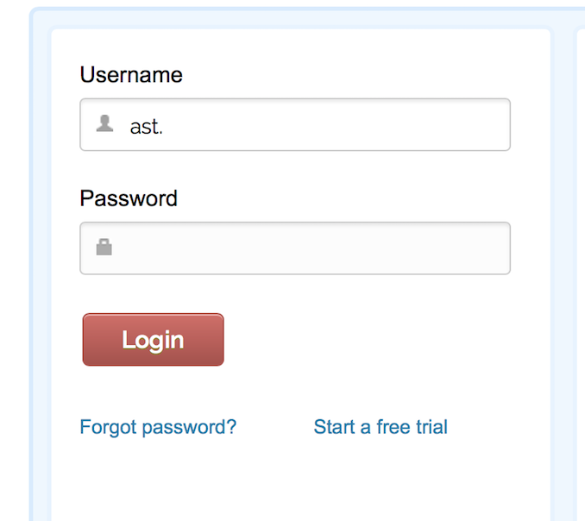
Catalyst: Tablet Log In
!
Leave open on PIN pad page to allow Catalyst to sync; sync every morning
ast.firstname/lastname
Password is emailed to you
Enter 6 digit PIN and press Login
Notes:
When logging on to a tablet for the first time, enter username and password from email sent to your work emial (select students, if applicable) and allow tablet time to verify, then enter 6 digit pin

Slide 9
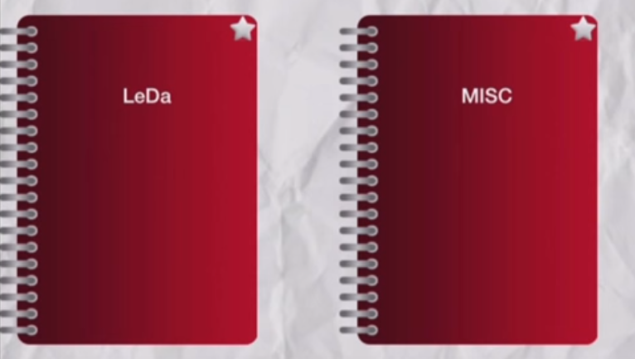
Client Notebooks
Once you log on, select client’s notebook. Notebooks labeled by client code (i.e., client’s first two initials and last two initials):

Slide 10
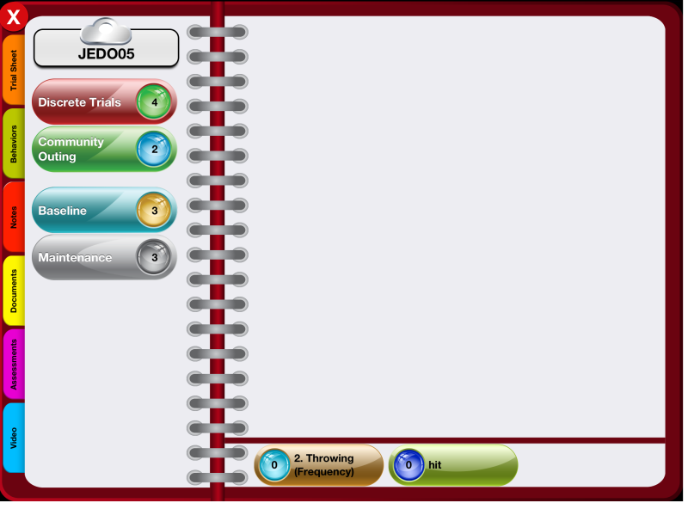
Catalyst: Client’s Home Screen
Client Code
Current programs/targets
Playlist for specific programs/targets,
if applicable
Future programs/targets
Previously acquired programs/targets
Fluency/Rate/ Frequency data
Notes:
Click on “Discrete Trials” to begin collecting data for your session

Slide 11
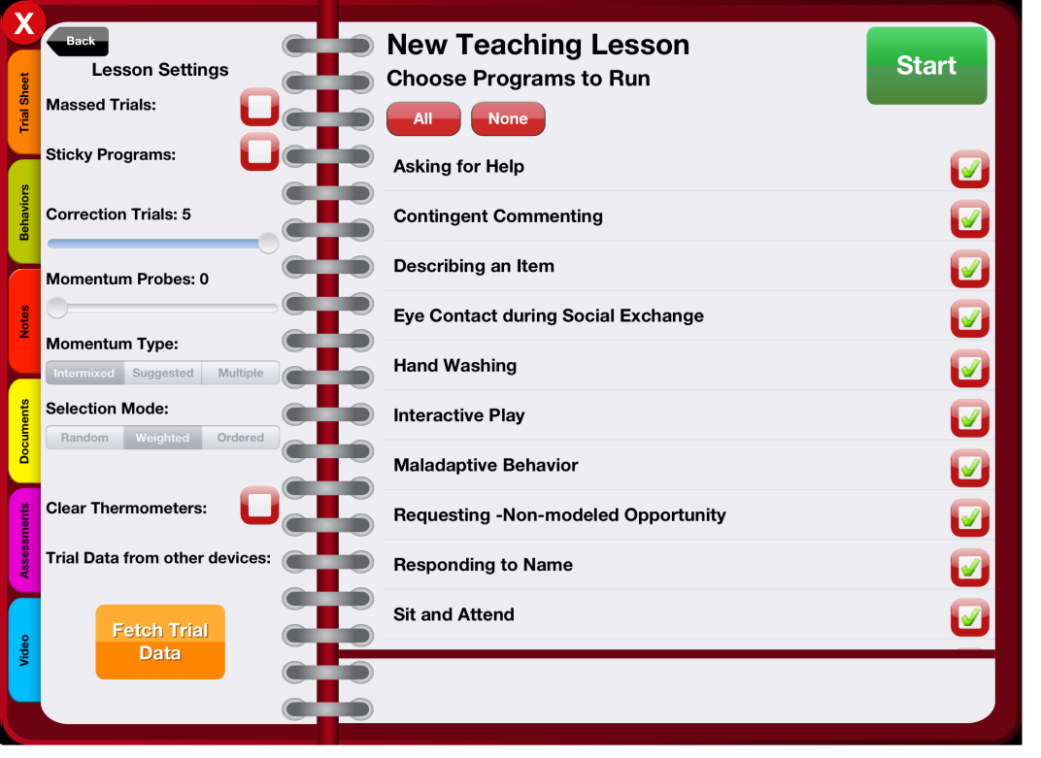
Running Session!
Exit notebook
To go back to client’s home screen

Slide 12
Running Session: Let’s Begin
2. Select targets to run
3. Press Start Session to begin collecting data
1. Check Massed Trials
Notes:
Note, even if you don’t run massed trials in your session, still select massed trials to help Catalyst run smoothly

Slide 13
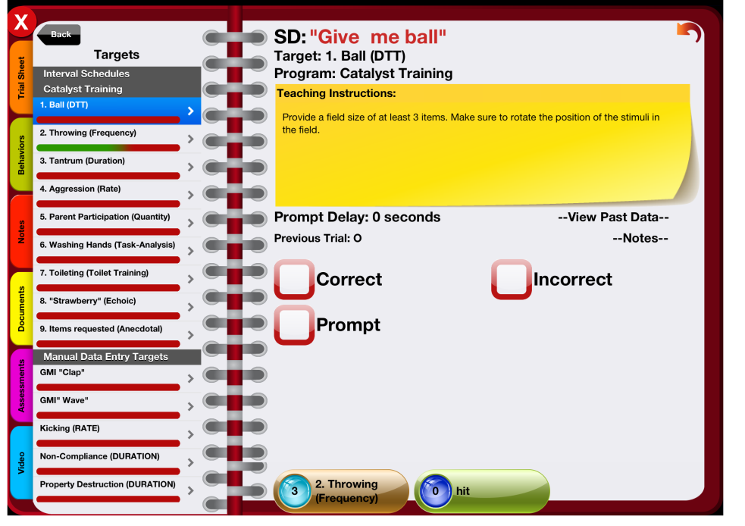
Running Session: The Basics
SD: Discriminative Stimulus (SD)/ instruction
Select Target
Teaching Instructions: Make sure to read this BEFORE you run the target. This is where you will find information about how to run the target and collect data.
Prompt Delay: How long to wait before you prompt
Previous Trial: Quick reference of last data collected

Slide 14
Types of Data Collection in Catalyst

Slide 15
Discrete Trial/Opportunity Based Data Collection
Discrete Trial/Opportunity: Used when the client has the opportunity to be correct or incorrect (e.g., following directions, listener responding, responding to greetings, etc.)
Data reported: as a percentage (%), record the number of times a behavior occurs over the total number of opportunities presented
How to calculate: Total number of correct responses divided by total opportunities presented, multiplied by 100
Active Student Responding! What’s a real-life example/behavior YOU engage in measured by percent of opportunity? ☺
# Correct _
Total # of Opportunities
x 100 = % Correct

Slide 16
Discrete Trial/Opportunity Based Data Collection
Red square boxes*: Select box/word to record data
*Note: Level of prompt may be indicated by different boxes (e.g., Gestural Prompt, Verbal Prompt, Partial Physical, Full Physical, etc.)

Slide 17
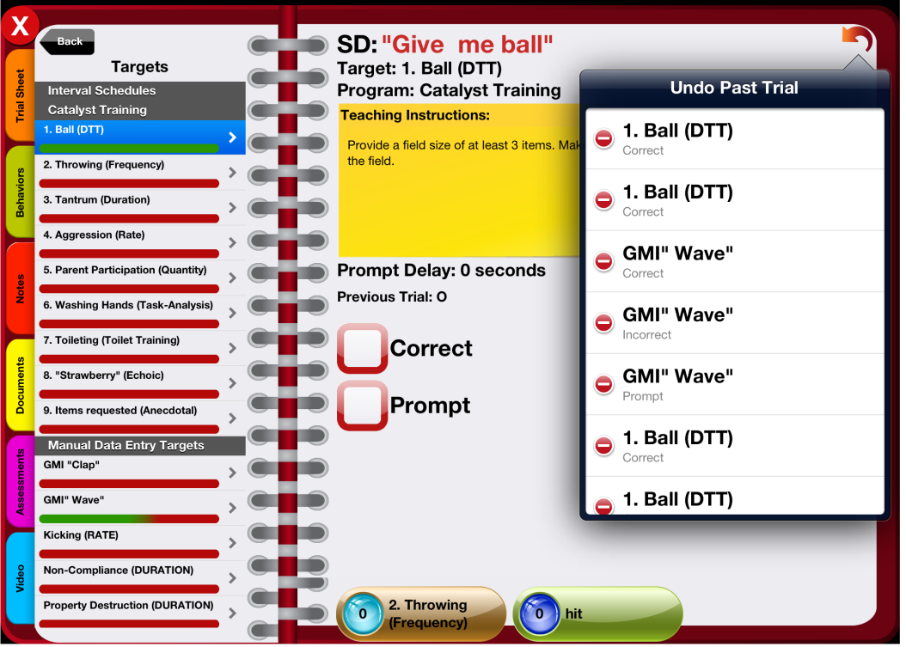
DTT Tips and Tricks!
To undo a trial, hit the red back arrow
Each step will be recorded as either correct or incorrect Click – to delete a trial
Note: only the most recent trials will be displayed here
The thermometer tracks how close you are to completing the required number of trials per session and helps you prioritize what to run.
Notes:
Your goal is to turn all thermometers green!
The thermometer turning green does not mean you are done! Its just the desired number of trials per session, you can always run more.

Slide 18

Practice!

Slide 19
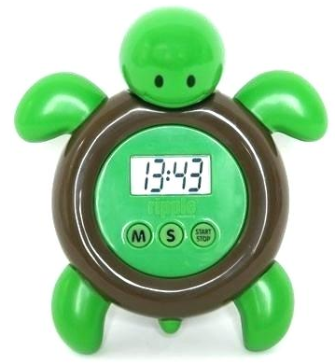
Duration Data Collection
Duration: Used for behavior that vary in time (e.g., tantrum, out of seat behavior, attending, etc.)
Data reported: Record amount of time a person engages in the target behavior; reported as total duration per session (e.g., 24 minutes of tantrum per 2 hour session) or average duration per occurrence (e.g., average of 3 minutes per tantrum)
How to calculate: Record total amount of time per occurrence of each behavior
Latency: Another data collection system that can use duration recording. Record the amount of time between the SD and the start of the response (e.g., time between instruction and when person begins to follow instruction, time between bites of food, etc.)
= 13 min 43 sec
Active Student Responding! What’s a real-life example/behavior YOU engage in measured by duration? ☺

Slide 20
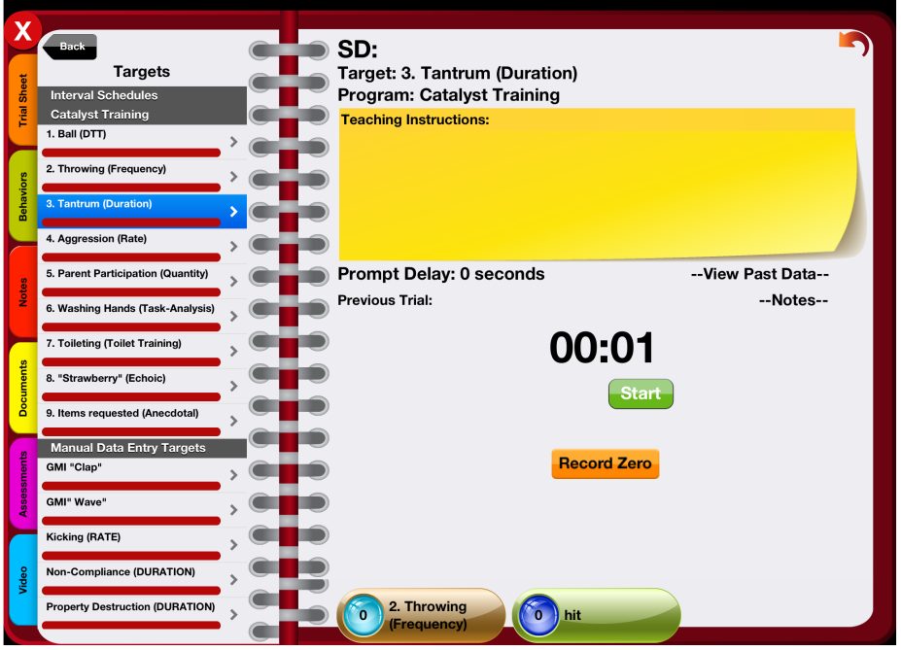
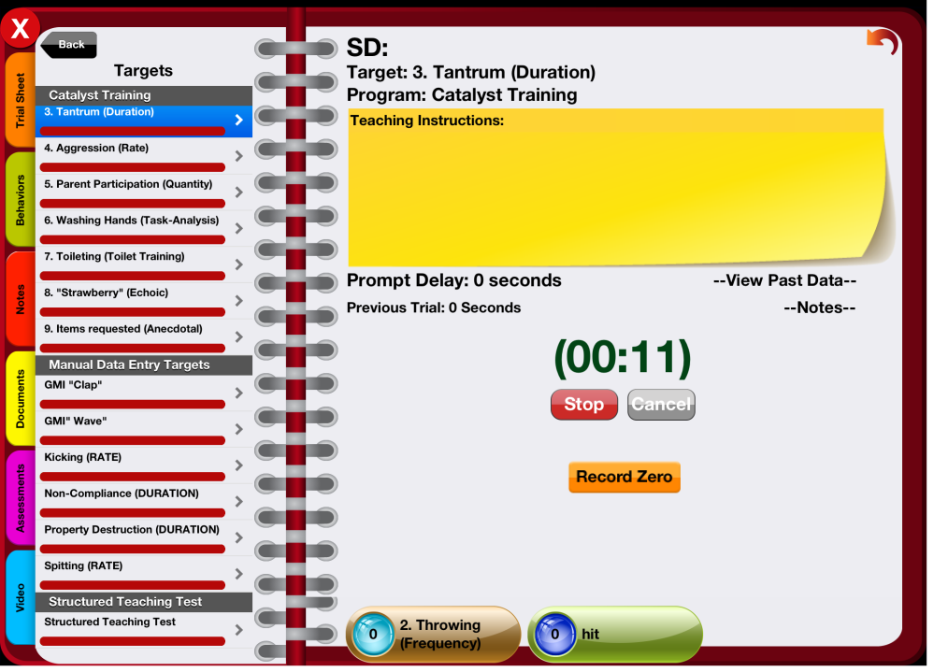
Duration Data Collection
Pro Tip!
Read teaching instructions to know when to start and stop your timers (onset and offset of target behavior)!
Tap Start button at the beginning of engagement in the target response
Tap Stop button when finished recording

Slide 21
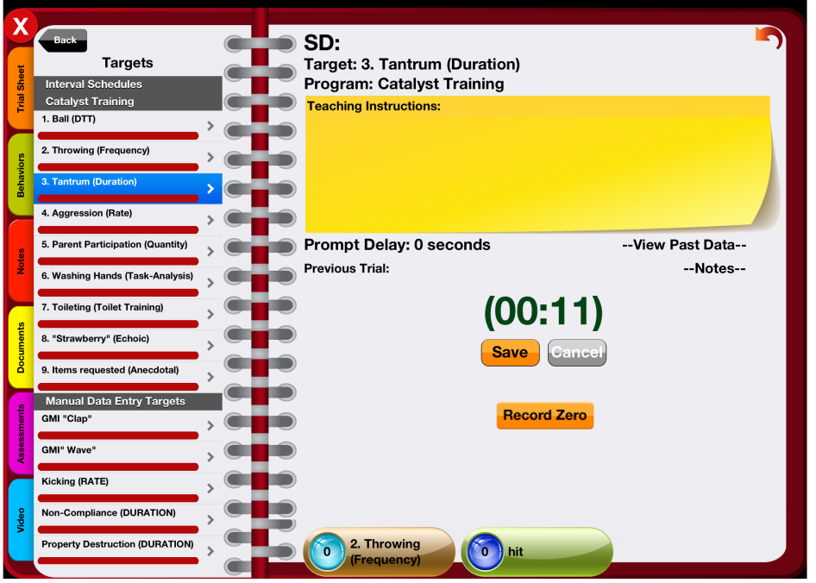
Duration Data Collection (continued)
After you stop the timer, tap Save to record the duration
Tap Record Zero if there was no engagement of the behavior during the entire session.
Remember, zero is a number too! ☺

Slide 22
Practice!

Slide 23
Fluency/Rate Data Collection
Fluency/Rate: Used for discrete behaviors that have a clear beginning and end (e.g., hitting, elopement, raising hand)
Data reported: Number per amount of time (e.g., 6 times per hour)
How to calculate: Number of instances divided by total minutes in observation period, multiplied by 60
# of Instances
Total # of Minutes
x 60 = Rate/Hour
Active Student Responding! What’s a real-life example/behavior YOU engage in measured by fluency/rate? ☺

Slide 24
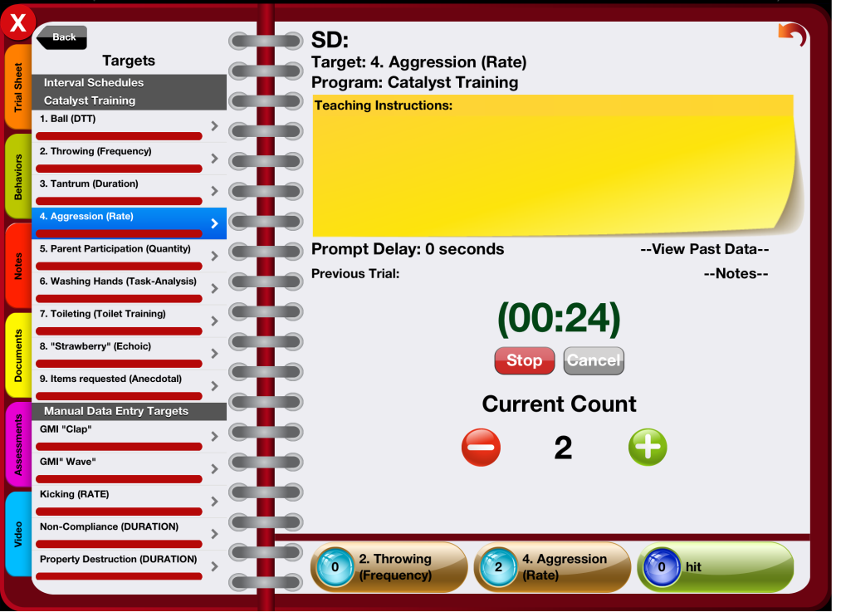
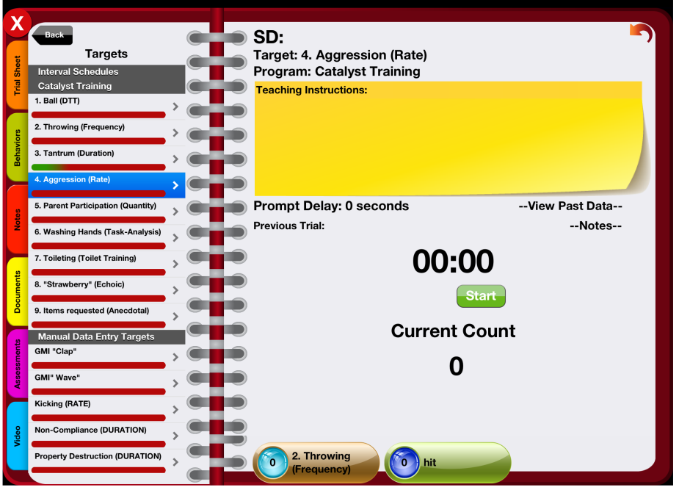
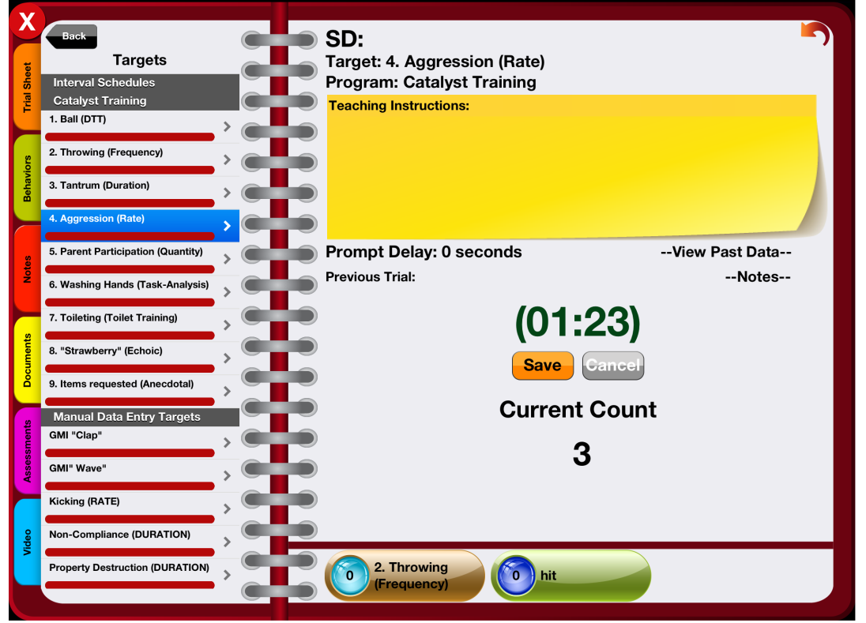
Fluency/ Rate
1. At the beginning of the observation period/ session tap Start
2. Record data:
Tap + to record each observed occurrence
Tap – to reduce the frequency (or use the frequency ribbon!)
3. Tap Stop at end of observation period/ session
4. Tap Save
Notes:
If you forget to stop your timers – email sup to delete and then add manually
if its still running hit cancel and add data to portal online
IMPORTANT: If there was not occurrence of the targeted behavior, interventionists are to record zero occurrence of data by tapping at the end of the session.

Slide 25
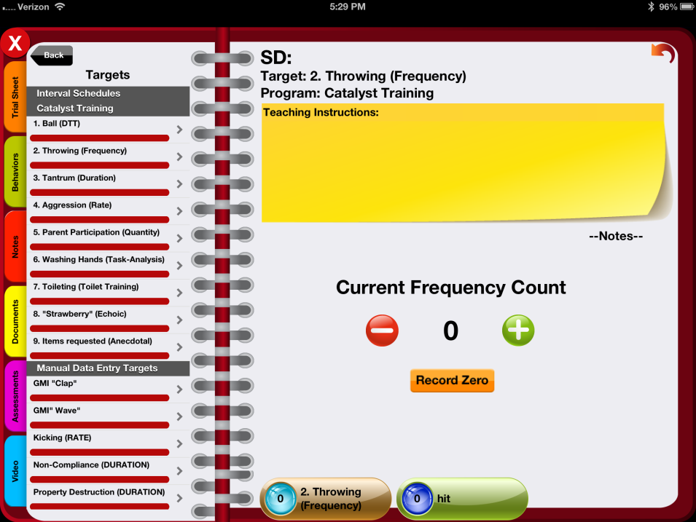
Frequency Data Collection (without timer)
Tap + to record each observed occurrence
Tap – to reduce the frequency
At end of session, if no occurrence of behavior, tap Record Zero
To record frequency using Frequency Ribbon, simply tap the button for the respective behavior per occurrence. The data recorded on both fields will sync automatically.
Notes:
IMPORTANT: If there was not occurrence of the targeted behavior, interventionists are to record zero occurrence of data by tapping at the end of the session.

Slide 26
Practice!

Slide 27
Quantity Data Collection
Quantity: Used for permanent outcome data (e.g., data taken by parent outside of session, parent participation, intensity data collection, distance traveled, etc.).
Note: quantity data recording is most commonly used to record percentage of parent participation throughout a session.
Data reported: Total number
How to calculate parent participation: Number of minutes parent participated divided by total minutes of session, multiplied by 100.
# of Minutes Participated
# of Minutes in Session
x 100 = % Participated
Notes:
Intensity Data Collection
One of the data collection systems that can use Quantity type is Intensity data collection.
Used for behaviors those vary in magnitude (e.g., hitting, volume of voice, etc.)
Record different magnitudes of a behavior on a predetermined scale
*Note: The predetermined levels must be explicitly defined and written prior to beginning data collection

Slide 28
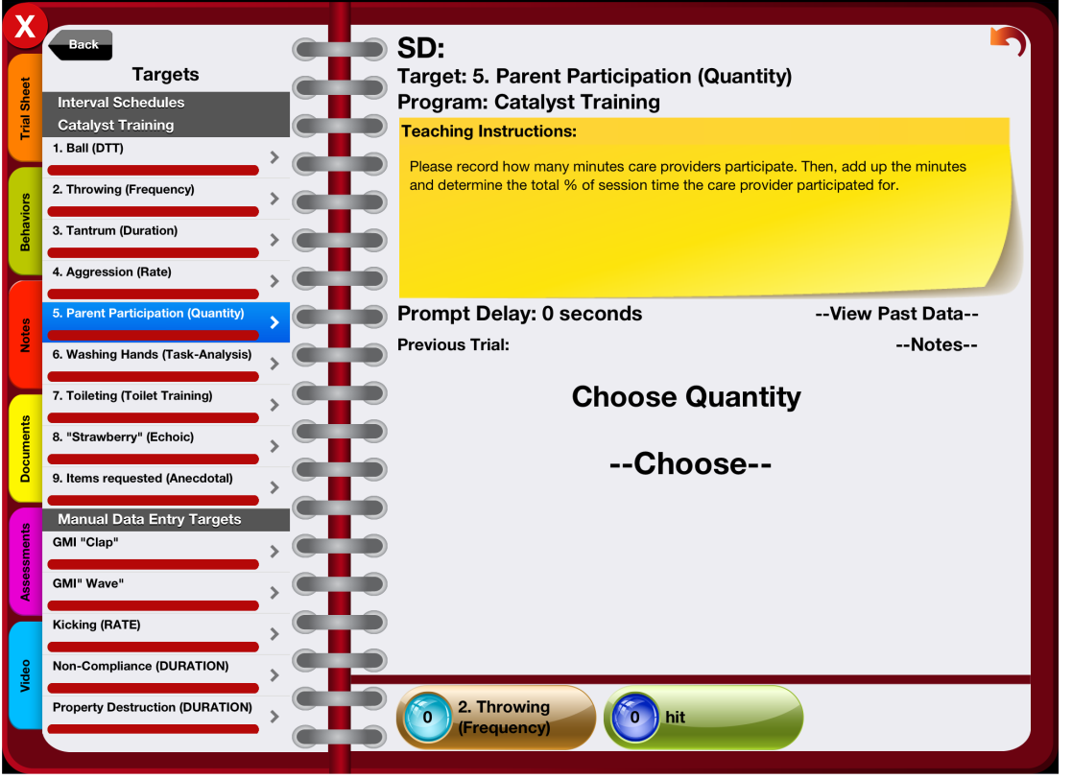
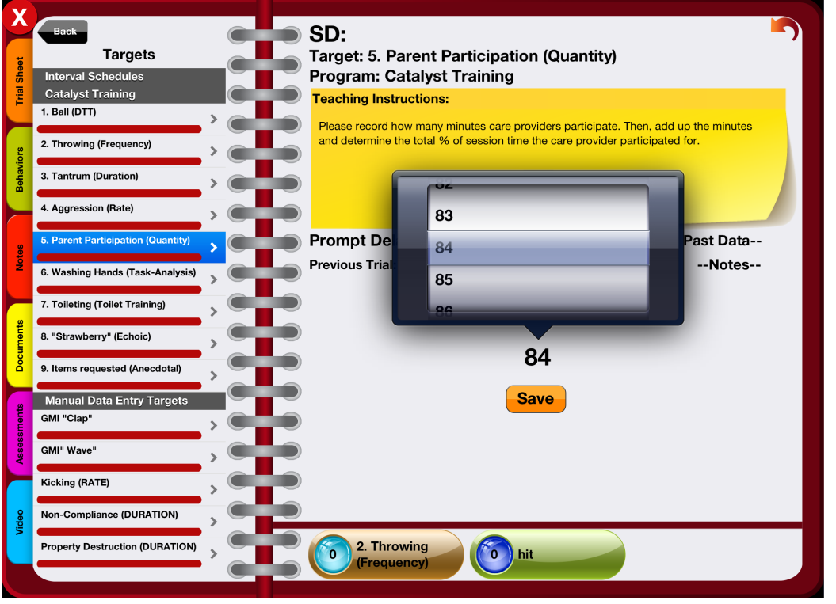
Quantity Target
1. Tap Choose
2. Select number
3. Tap Save

Slide 29
Practice!

Slide 30
Task Analysis Data Collection
Task Analysis: Used most commonly to measure level of independence across steps of a task (e.g., washing hands, brushing teeth, etc.).
Data reported: Number of independent steps of over the total number of steps in a task
How to calculate: Number of independent steps divided by total steps, multiplied by 100
# Independent Steps
Total # of Steps
x 100 = % of Independence
Active Student Responding! What’s a real-life example/behavior YOU engage in measured by task analysis? ☺

Slide 31
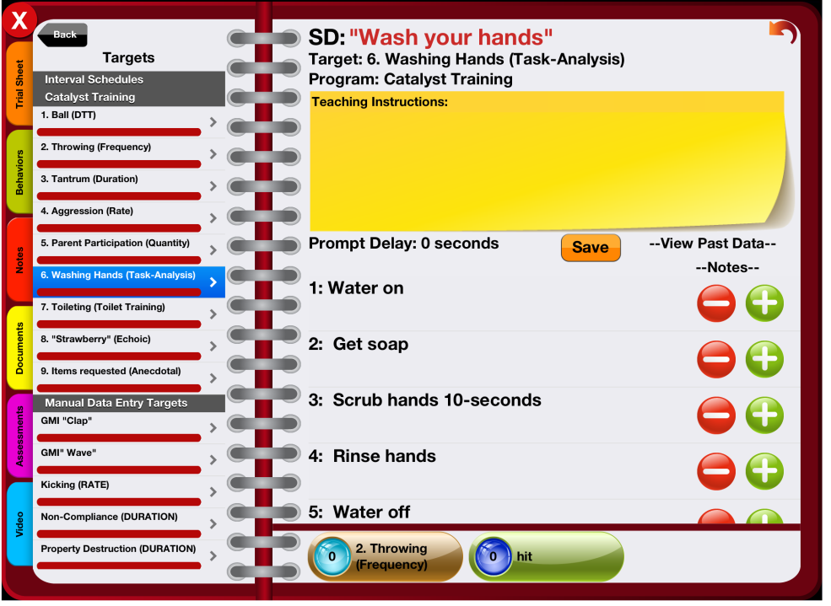
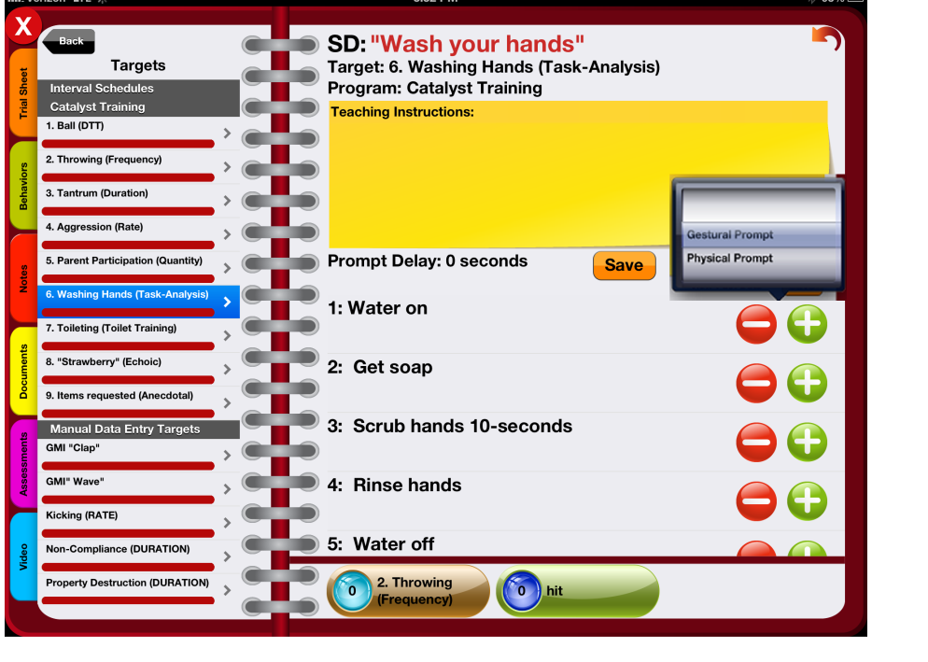
Task Analysis
You may also need to select the level of prompt delivered
Click Save once finished
Record each step as either correct + or incorrect -
Notes:
You may also navigate away from the task analysis if needed, just remember to click SAVE once finished.
Click three lines on right to view past data for the day

Slide 32
Practice!

Slide 33
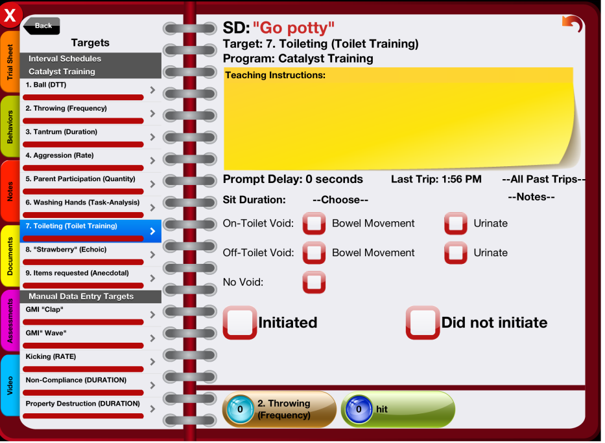
Toileting Data Collection
Select Sit Duration, if applicable
Select appropriate behavior
Select Initiated or Did not initiate
Important! Selecting one of these buttons is what saves the toileting data.

Slide 34
Toileting: Cool Features!
Last trip shows you the last time data was recorded
All Past Trips shows you all time and behavior recorded for the day
Notes:
Click three lines on right to view past data for the day

Slide 35
Practice!

Slide 36
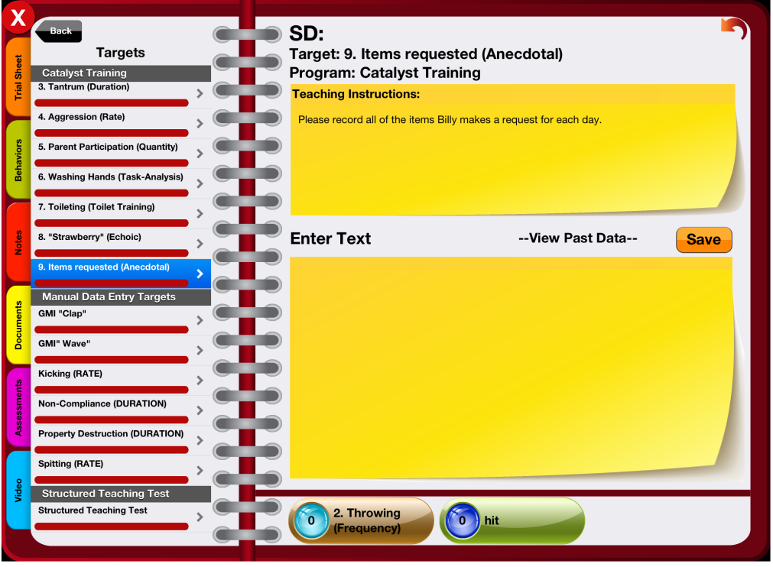
Anecdotal Data Collection
Anecdotal Data Collection: Used most commonly to record text (e.g., specific items requested, etc.)
Data reported: As text
Enter Text
Click Save
Note: You may need to save each word individually –
refer to manager/teaching instructions to confirm

Slide 37
Practice!

Slide 38
Interval Recording Data Collection
Interval Recording: Used to measure continuous behaviors (e.g., cooperative play) or behaviors that occur at such high rates that observers have difficulty distinguishing one response from another (e.g., humming, rocking)
Data reported: Observation period is divided into intervals (e.g., 10 minute segment divided is into 1 minute intervals) and presence or absence of behavior during intervals is recorded
Whole Interval Recording
Record behavior if it occurs for the entire interval
+ = behavior occurred for the entire interval (in Catalyst this is denoted by checking the box)
– = behavior did NOT occur for entire interval (in Catalyst this is denoted by NOT checking the box)
Partial Interval Recording
Record behavior if it occurs at any time during the interval
+ = behavior occurred at any time during the interval (in Catalyst this is denoted by checking the box)
– = behavior did NOT occur at any time throughout the interval (in Catalyst this is denoted by NOT checking the box)
How to calculate: Number of intervals target behavior occurred divided by total intervals, multiplied by 100

Slide 39
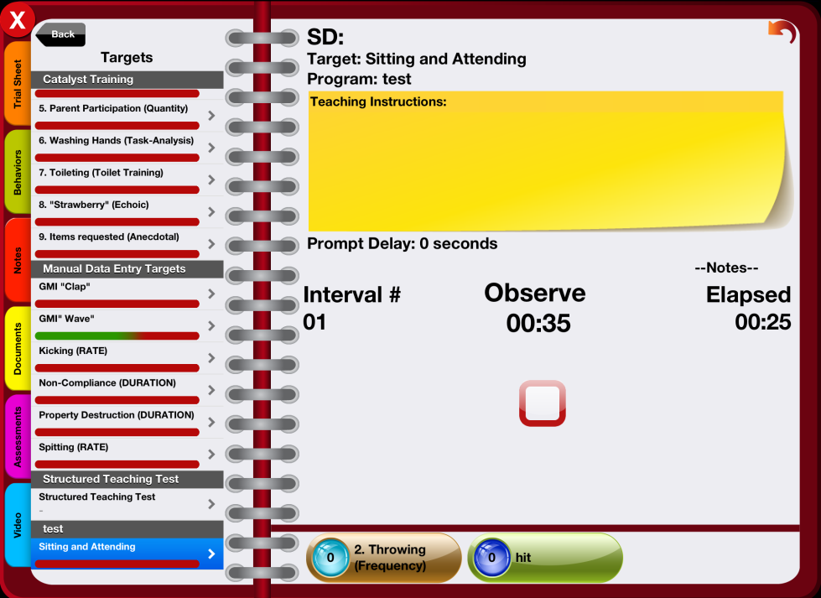
Interval Recording
This will state “Observe” or “Record”. It is the time currently in the observation and/or recording period.
Interval #
Total time elapsed
Mark occurrence of behavior here

Slide 40
Practice!
Notes:
With hand flapping video

Slide 41
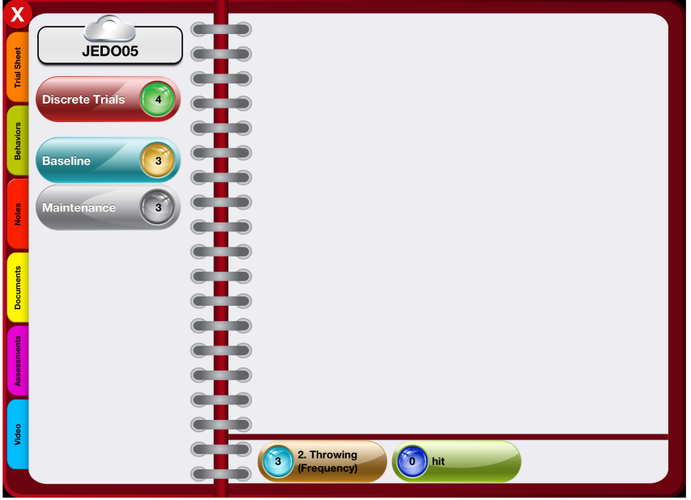
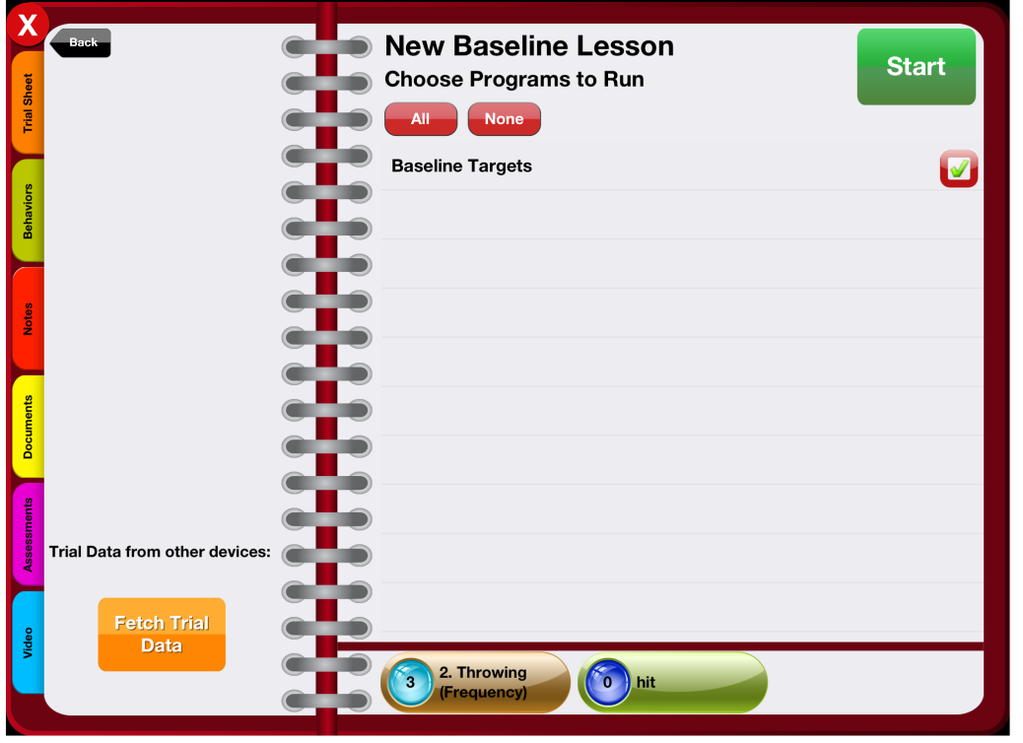
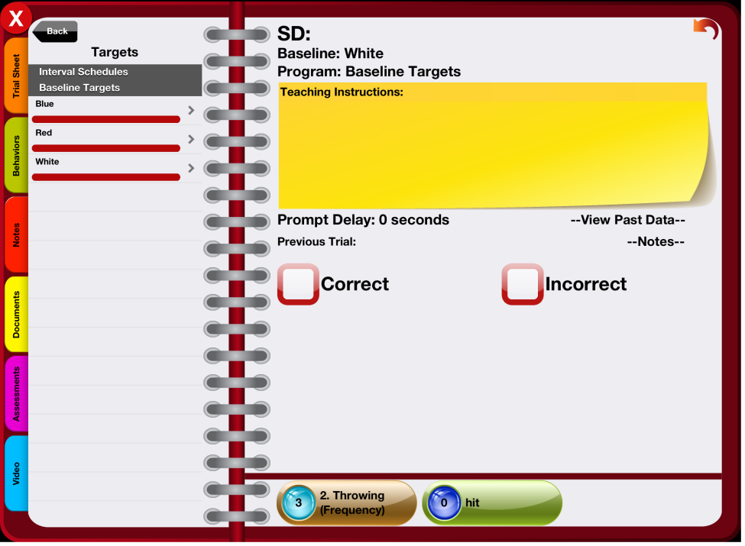
Baseline
Select Baseline
Check mark programs to run and hit Start
Record responses

Slide 42
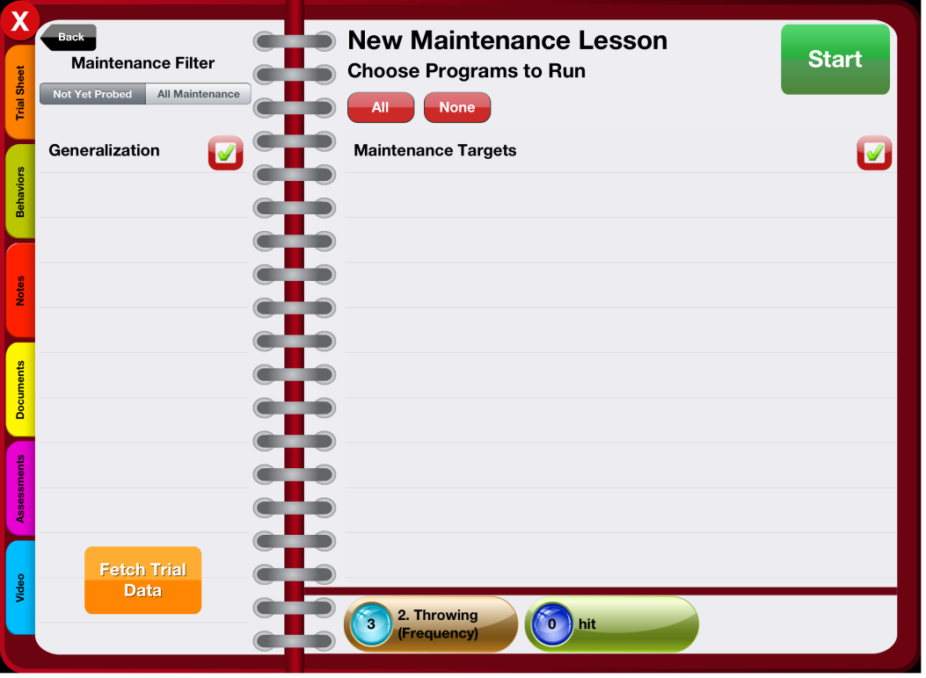
Maintenance
Collecting maintenance data is very similar to collecting baseline data with two exceptions:
A maintenance filter appears on the left
Select Maintenance

Slide 43
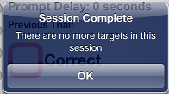
For both Baseline and Maintenance Data:
Once every trial has been targeted for baseline or maintenance, a window will appear on the screen to indicate that all baseline or maintenance trials have been completed for the session.

Slide 44
Practice!

Slide 45
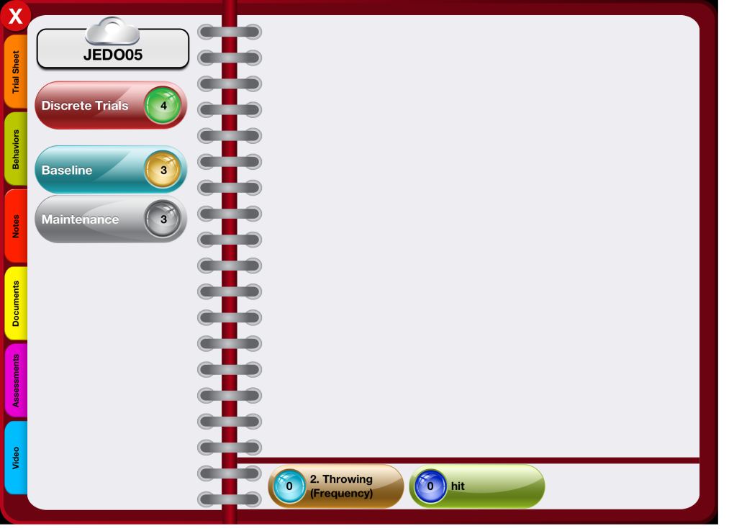
Client’s Home Screen: Tabs
Trial Sheet
Behaviors
Notes
Documents
Assessments
Video
Notes:
Trial Sheet: accessing trial sheet and graphs
Behaviors: manager/supervisor will direct you how to use if necessary
Notes: manager/supervisor will direct you how to use if necessary
Documents: to access protocols
Assessments: access manager/supervisor notes here; manager/supervisor will direct you how to use forms on this tab if necessary
Videos: how to video tape client

Slide 46
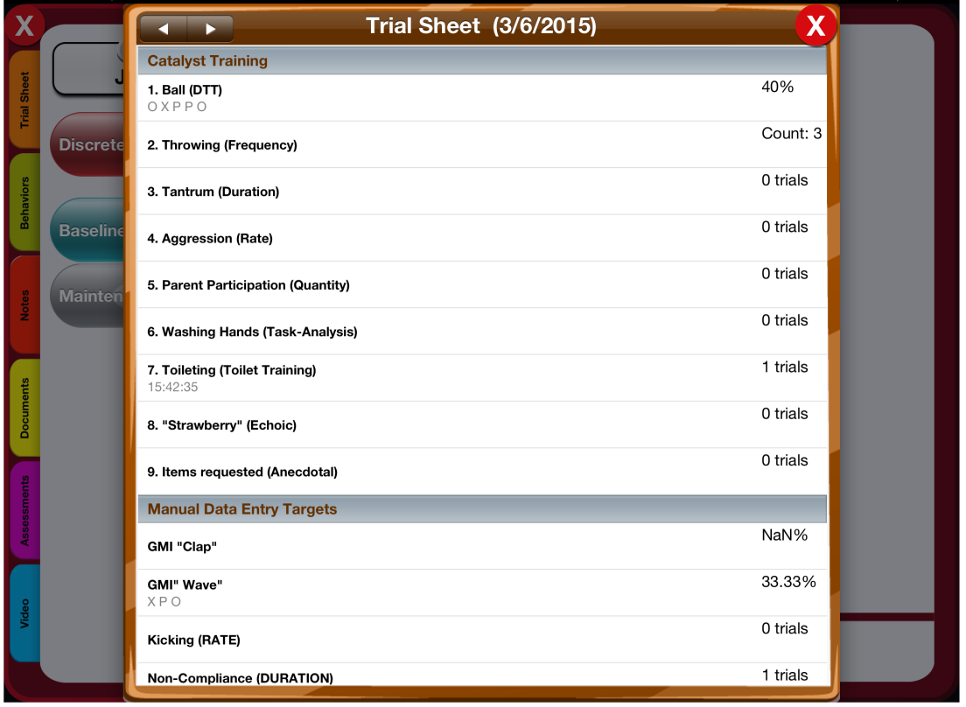
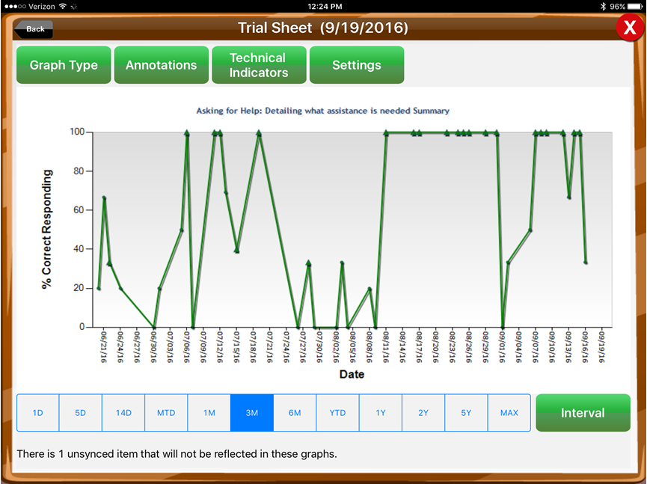
Trial Sheet Tab
Select a specific target to view graph
Note: you must be connected to WIFI to view graphs
View total trials and percentages here
Tap the arrow to view previous sessions
Notes:
Talk to your sup about how analyze, understand, and discuss graphs

Slide 47
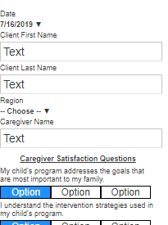
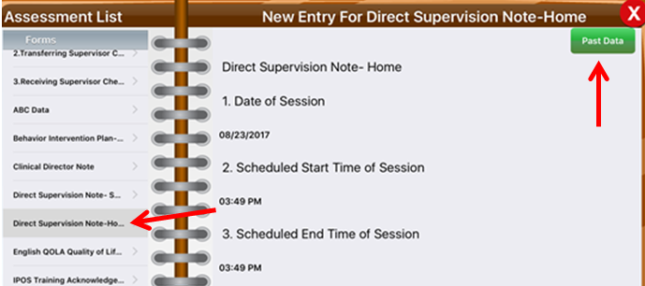
Assessment Tab
Direct Supervision/Protocol Modification
To see Manager notes in the app:
Go to the assessment tab
Select “Direct Supervision Note-Home” or “Direct Supervision Note-School”
Select Past Data in the top right corner that says “Past Data.”
Parent Pulse Survey
To access parent pulse survey, if directed by supervisor/manager:
Go to assessment tab
Select “Parent Pulse Survey”

Slide 48
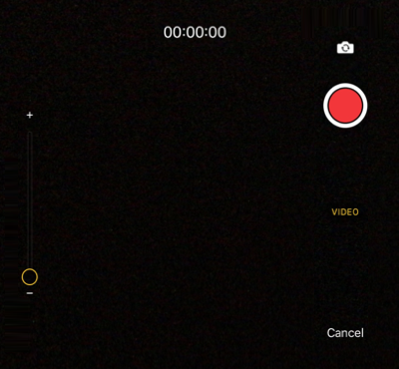
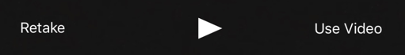
Video Tab
Orient device
Click red record button*
Save or retake video
If saving video, title it and add a note
Once saved, video will only be viewable on the portal
*Recommended that videos are 5 minutes or less due to challenges associated with syncing larger videos

Slide 49

OOPS!
If you forget to stop/save rate or duration timers, record the correct data on paper (if possible – this may not be possible for duration targets), clear the timer, then add the correct data to the portal.
If you make a mistake and need data to be deleted, you need to ask your manager to delete the data point for you. It is then your responsibility to enter the correct data on the portal and give the raw/paper data to your manager.

Slide 50
The Catalyst Online Portal

Slide 51
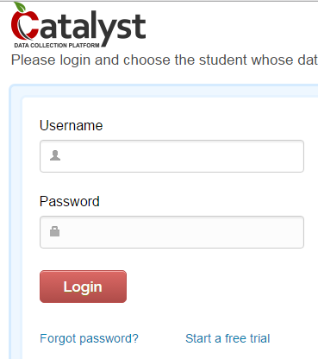
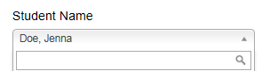
Online Portal
Go to https://secure.datafinch.com
When logging in for the first time, please select Forgot password? and enter your username
Username: ast.xxxxxxxx (ast.firstnamelastname)
To access an existing client account, chose the client from the drop-down list and click Continue. You can also type the student’s name into the search box.
Notes:
For now, don’t use SSO to access Catalyst if your area has SSO.

Slide 52
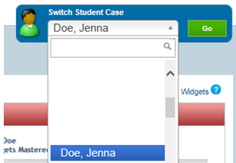
Navigating the Portal
The Switch Student Case drop-down menu: allows you to view or search for each client individually. Remember to click the Go button.
Tabs: Technicians will primarily use the Data Entry Tab, Documentation Tab, and Skill Acquisition Tab.

Slide 53
Data Entry Tab
The primary source of data collection for Catalyst is done on the tablet
If your devices fails in the field or if there are additional data that need to be added, you will enter the data in the portal. Discuss with your supervisor/manager when you should add data to the portal.
There can be issues when using Internet Explorer to enter data on Catalyst, so please enter data in another browser (e.g., Safari, Chrome, Firefox).

Slide 54
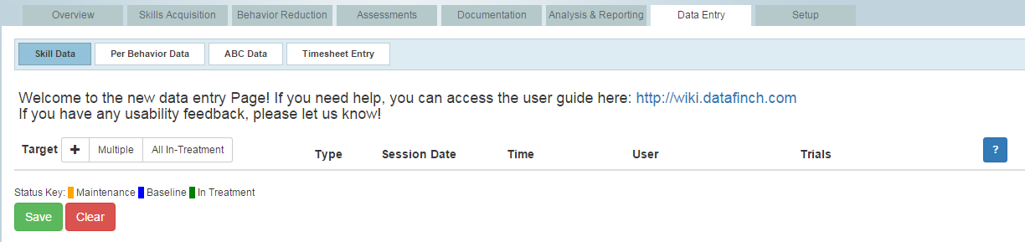
Entering Data
Go to Skill Data under Data Entry
Click All-In Treatment to add all current targets
Click + to add/select a single target
Click Multiple to add/select multiple targets

Slide 55
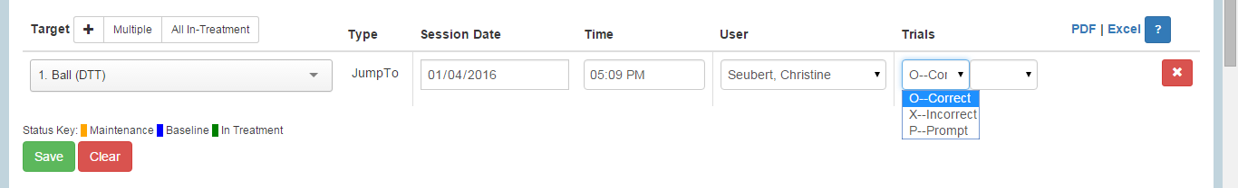
Entering Data
For each target: add session date, session time, your name (under “user”), and the raw data.
*IMPORTANT. Once all data are entered on the page, please click save button at the bottom left corner of the screen.
You will see a notice that your targets were saved successfully. You may get an error if not every target was entered. If you have a target on the page that you do not have data to enter, delete the target by clicking the red x to the right of the target.
Tips!
In order to enter multiple trials for a target simply use the tab button and first letter of the prompt code (e.g., O for Correct).
Durations should be entered in hh:mm:ss format. (For example, if time was 2 hours and 30 minutes, you should enter it as 02:30:00).

Slide 56
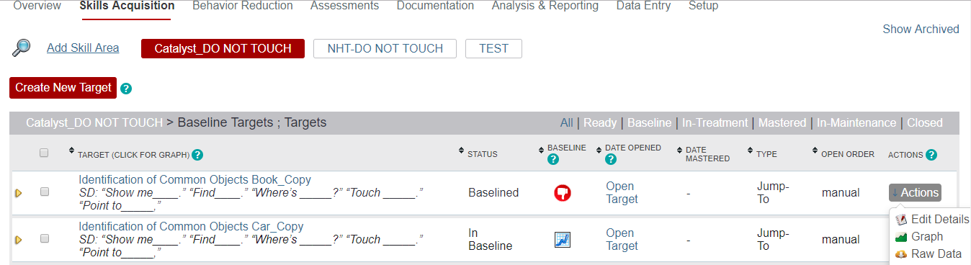
Checking Data Entry
Once you save your data entry, you can check the raw data:
Go to the Skill Acquisition Tab
Find the Program
Find the Target/Goal
Click Actions on the right
Click on Raw Data
Check your data (most current data will be first)

Slide 57
Documentation Tab
This is where you will find client videos and documents uploaded by your manager/supervisor (e.g., protocols, Behavior Intervention Plans, etc.)

Slide 58
Practice!

Slide 59
Obtaining Catalyst Support - Where to go for help!
IT Department:
All things related to tablet (e.g., charger, case, tablet login and password, etc.)
The Following Catalyst issues:
Updates, app freezing, not syncing, folder not created, folder renaming, folder disappearing, username/password
DataFinch:
Support@datafinch.com, chat on portal, OR submit support request
Following Catalyst issues:
Data missing, clock issues, Catalyst features
Catalyst passwords:
Portal password → reset on Catalyst portal/website
Pin password → reset on Catalyst portal/website
Scheduling:
Access to Client
Supervisor/Manager:
Any client specific questions, deletion of data, help with collecting data
Quick Catalyst Question - https://dftcatalyst.zendesk.com/
Notes:
IMPORTANT:
***You should see all of your regularly scheduled clients automatically.
***If assigned a same-day alternate case, you should automatically see the client once you re-sync your app for the day (if you do not see the same-day alternate client after re-syncing your device, contact scheduling for support).

Slide 60
Catalyst and Tablet Expectations

Slide 61

Caring for your Tablet
Charge your tablet to 100% every night. Conserve battery power during the day by powering off your device between clients.
Keep your tablet free of stickers and markings.
Take your tablet with you (i.e., do not leave it in your car during the day or night).
Keep your tablet safe (e.g., keep it away from water, don’t put on the floor where it can be stepped on, or give to clients).
Get parent and manager approval to use YouTube and Google Images for client programs.
The tablet is company property.
Only use the tablet for work related activities.
Any wallpaper pictures should be work-appropriate.
Loss or damage of your tablet should be reported to your primary supervisor (who will report this to IT) within 24 hours.

Slide 62
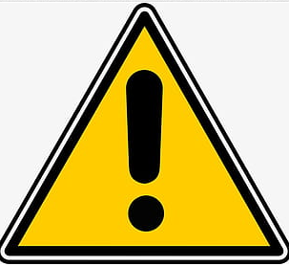
Security and HIPAA Compliance
If you start your day and end your day with a center-based client or in the same office, you can feel free to charge your tablet at either the Newton or Wilmington office overnight.
Do not upload Catalyst onto any of your personal devices, as tis should only be used on your ALC tablet.
Use secure (password protected) WiFi when synching data to your tablet:
For security purposes, the strong preference is for this to be synched when at your home, at a client’s home, or in an ALC office.
If you absolutely must connect to WiFi outside of these locations, please be sure to only connect to a network that requires a password to connect.

Slide 63
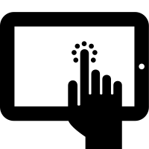
Using Catalyst on Your Tablet
Sync your app every morning so you have all of the latest updates.
If you are scheduled to see an alternate client the same day, please make sure to re-sync your app before entering the client’s home so you have access to his/her folder in Catalyst. If you do not have access after re-syncing your app, reach out to scheduling for help.
If your tablet fails out in the field, please go back to paper and pencil data.
Do not spend more than 5-minutes of your session trying to problem solve. Use the data sheets in your “back-up binder” for the session.
It is then your responsibility to enter the data on the portal. Remember to save your raw/paper data and give to your manager.
Only take videos of clients in the Catalyst app (do not use the tablet camera to take pictures or videos of clients).
Do not take videos for purposes of BACB supervision through the Catalyst app!
Reset your Catalyst password on Catalyst Portal by selecting “Forgot your password?”
Please be patient when tapping your tablet (sometimes it takes a moment for the tablet to register the tap).
TAP and WAIT ☺; Tap in the box or the word itself (not around it)
Remember to start and stop your rate timers and record zero.
Notes:
Tips for remembering to start and stop rate timers: set a reminder or alarm on the tablet.

Slide 64
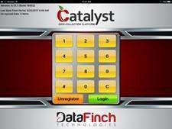
Troubleshooting
“I can’t see my client’s notebook when I log onto the Catalyst app.”
Solution: Contact scheduling. Once scheduling adds the client, reregister Catalyst:
Reregistering Catalyst:
Connect to WIFI
Tap Unregister on the pinpad
Enter your Catalyst username and password (this process might take a while to complete depending on the network speed and the number of clients that you can access)
Enter your pin number

Slide 65
Tips and Tricks!
If your supervisor updates a program from his/her computer, it takes about 10-30 seconds for this to update in the tablet.
If you can’t login to your device for any reason, try clearing your browser history and this usually alleviates this problem.
It may be helpful to use a stylus or strap, and if you’d like to purchase one or either of these you may certainly do so!

Slide 66
Practice! Let’s Put it all Together!

Slide 67

Thank you!

